Slide 1
QUADRATIC EQUATIONS
TMS 1113 – Foundation of Mathematics
1
Notes:
1

Slide 2
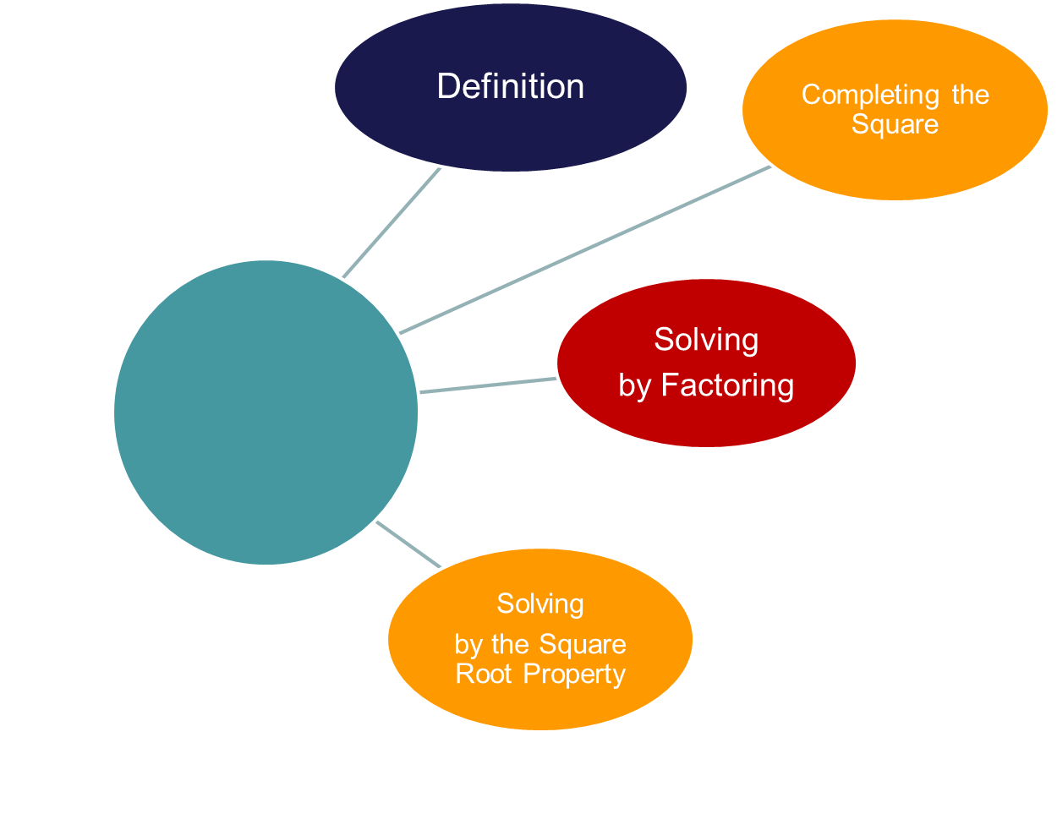
Objectives
Objectives
Solving by the Quadratic Formula
2
Notes:
2

Slide 3
Algebraic Expressions
2xy is formed by the product of 2, x and y. Therefore, 2, x and y are all factors of 2xy
2x + 2y is a binomial expression (two terms separated by a + or - sign)
It is the sum of two algebraic terms.
2 and x are factors of 2x
2 and y are factors of 2y. Accordingly, 2 is a factor of both the terms 2x and 2y
2x + 2y can be written as 2 (x + y) by factoring out the common factor 2
2x + 2y = 2 (x + y)

Slide 4
2x + 2y = 2(x+y)
2 and x + y are factors of 2x + 2y
Factors of : xy + 5xz
xy + 5xz = x(y + 5z), x and y + 5z are factors of it
Ex: 1. 3x + 12
2. 6a + 12b –18
3. – 2x – 6y
4. 3x – 6xy

Slide 5
2x + 2y = 2(x+y)
2 and x + y are factors of 2x + 2y
Factors of : xy + 5xz
xy + 5xz = x(y + 5z), x and y + 5z are factors of it
Ex: 1. 3x + 12 = 3 (x + 4)
2. 6a + 12b –18 = 6 (a + 2b – 3)
3. – 2x – 6y = –2 (x + 3y)
4. 3x – 6xy = 3x (1 – 2y)

Slide 6
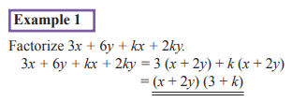
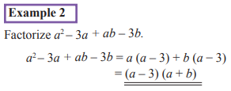
Factorize

Slide 7
Factorize each of the following algebraic expressions
ax + ay + 3x + 3y
2a – 8a + 2a – 16
2y – 7y – 2y + 14
ax – a – x + 1

Slide 8
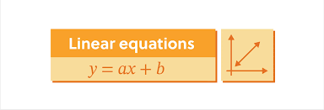
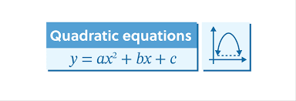

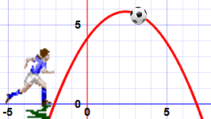
Quadratic Expressions
Equation: 𝑎𝑥²+𝑏𝑥+𝑐=0 where a ≠ 0.
Key components:
  𝑎 → Quadratic coefficient
  𝑏 → Linear coefficient
  𝑐 → Constant term
Examples:
x² + 5x + 63
5x² - 7x + 2
x² - 4

Slide 9
Quadratic Expressions
Product of the two algebraic expressions (x + 3) and (x + 4)
(x + 3) (x + 4) = x (x + 4) + 3 (x + 4)
= x² + 4x + 3x + 12
= x² + 7x + 12
Therefore,
(x + 3) and (x + 4) are factors of x² + 7x + 12

Slide 10
Methods for Solving Quadratic Equations
Factoring
Completing the square
Quadratic formula

Slide 11
Method 1 – Factoring
Solve 𝑥²−5𝑥+6=0
Find two numbers that multiply to 6 and add to -5 → ( -2, -3 ).
Factorize: (𝑥−2)(𝑥−3)=0
𝑥=2, 𝑥=3

Slide 12
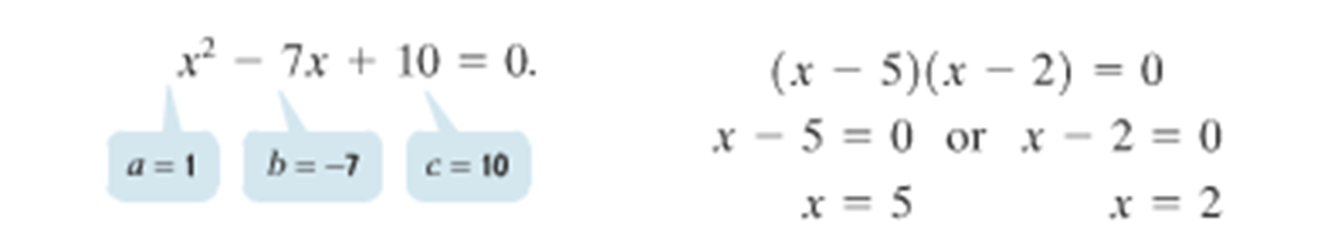
X²-7x+10=0

Slide 13
2x²−7x−4=0
3x²+18x+15=0
2x²−5x+1=0
5x²−x−2=0

Slide 14
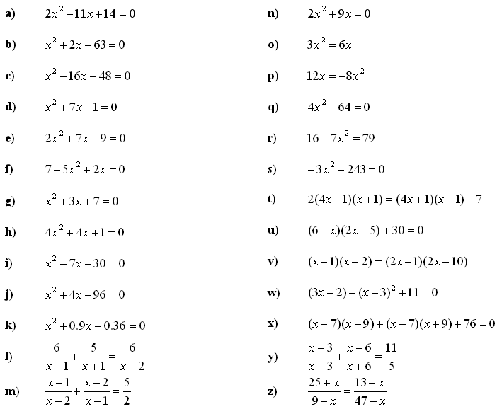

Slide 15
Method 2 – Completing the Square
Solve 𝑥²+6𝑥+5=0
Rewrite: 𝑥²+6𝑥=−5
Add (6/2)²=9 to both sides:(𝑥+3)²=4
𝑥+3=±2, so 𝑥=−1,−5

Slide 16

Solve x²+6x+5=0
x2+6x=−5
Take half of the coefficient of x and square it:
Add 9 to both sides
x²+6x+9=−5+9
Write as a square (x+3)²=4
Take the square root on both sides x+3=±2
x=−3+2=−1 x=−3−2=−5
x=−1, x=−5

Slide 17
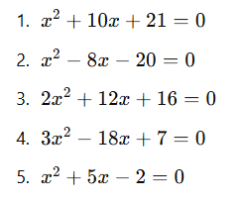
Solve using the completing the square method
x²−4x−5=0
2x²+8x+3=0 (Divide by the coefficient of x²)
x ² +7x−4=0
4𝑥²−12𝑥+5=0
𝑥²−6𝑥+2=0

Slide 18

Method 3 – Quadratic Formula
2x²−3x−2=0.

Slide 19

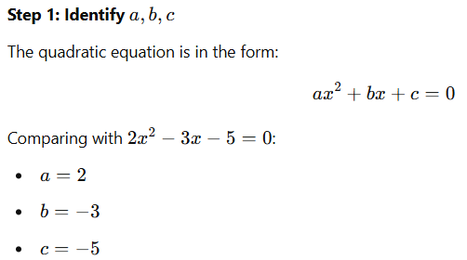
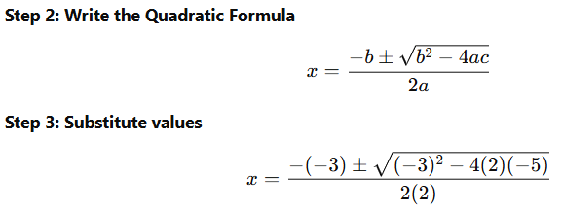

Slide 20
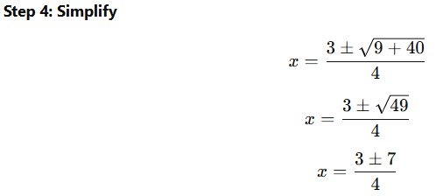
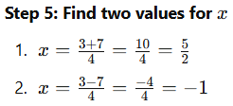


Slide 21
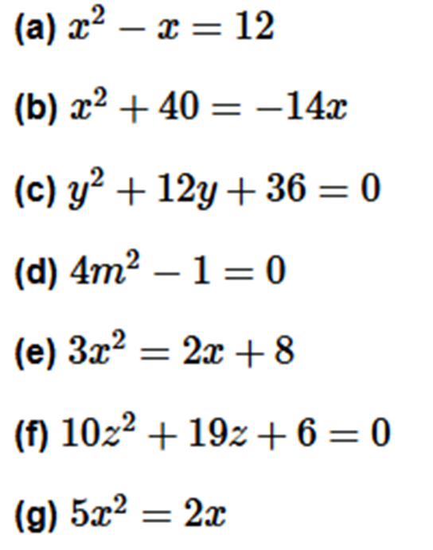
Solve using Quadratic Formula

